Slide 1
MALLA REDDY UNIVERSITY
MR22-1CS0148: DATA MINING
II Year B.Tech. CSE iI - Sem
(MRU-R22)
UNIT-Ii

Slide 2
Data Preprocessing - Overview, Data Cleaning, Data Integration, Data Reduction, Data Transformation and Data Discretization.

Slide 3
INTRODUCTION TO DATA PRE-PROCESSING
Data pre-processing
The data present in the data warehouse may contain noisy, missing, and inconsistent data, data is to be preprocessed in order to help improve the quality of the data and data be preprocessed so as to improve the efficiency and ease of the mining process.

Slide 4
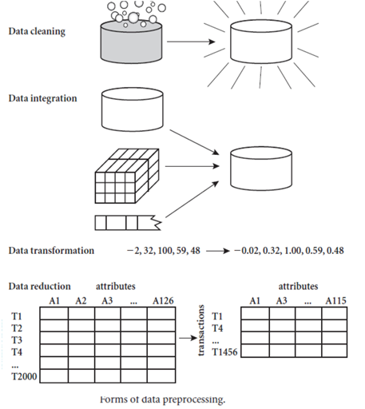
Steps in data preprocessing
The methods for data preprocessing are organized into the following categories
Data cleaning
Data integration
Data reduction
Data transformation

Slide 5
data cleaning
Real-world data tend to be incomplete, noisy, and inconsistent. Data cleaning (or data cleansing) routines attempt to fill in missing values, smooth out noise while identifying outliers, and correct inconsistencies in the data.
Data cleaning looks at ways of handling missing values, smoothing data to remove noisy data.
Missing values:
In order to handle these missing values, the following methods are employed by the data cleaning process.
Ignore the tuple:
This is usually done when the class label is missing (assuming the mining task involves classification). This method is not very effective, unless the tuple contains several attributes with missing values. It is especially poor when the percentage of missing values per attribute vary considerably.

Slide 6
Fill in the missing values manually:
In general, this approach is time-consuming and may not be feasible given a large data set with many missing values.
Use a global constant to fill in the missing value:
Replace all missing attribute values by the same constant, such as a label like “Unknown” or ∞. If missing values are replaced by, say, “Unknown,” then the mining program may mistakenly think that they form an interesting concept, since they all have a value in common that of “Unknown.”
Use the attribute mean to fill in the missing value:
For example, suppose that the average income of All Electronics customers is $56,000. Use this value to replace the missing value for income.
Use the attributes mean of all samples belonging to the same class as the given tuple:
For example, if classifying customers, according to credit risk, replace the missing value with the average income value for customers in the same credit risk category as that of the given tuple.

Slide 7
Use the most probable value to fill in the missing value:
This may be determined by regression, inference-based tools using a Bayesian formalism, or decision tree induction. For example, using the other customer attributes in your data set, you may construct a decision tree to predict the missing values for income.
Steps for performing data cleaning
Discrepancy Detection.
Data transformation.

Slide 8
data integration.
Data integration, which combines data from multiple sources into a data store as data warehousing.These sources may include multiple databases,data cubes or data files.
There are a number of issues to consider during data integration. They are as follows,
Schema integration and Objects matching.
Redundancy and inconsistency.
Detection and resolution of data value conflicts.

Slide 9
data smoothing techniques.
Noise is a random error or variance in a measured variable.
Now we will see some of the following data smoothing techniques:
Binning.
Regression.
Clustering.
Binning Method:
This method removes the noisy data value from the sorted data set by communicating with its neighboring values.It is considered as local smoothing because it communicates with the values which are around it.Before initiating any of the binning methods,it is necessary to sort the given list either in increasing or decreasing order.The sorted list is then divided into a number of buckets or bins with equivalent frequency or width.

Slide 10
a. By calculating the average mean of Bin:
This method calculates the average of data values for individual buckets and substitutes the existing values with the averaged value.
Ex:4,8,15,21,21,24,25,28,34
Partition into (equal frequency) bins:
Bin 1: 4,8,15
Bin 2: 21,21,24
Bin 3: 25,28,34.
The average of bucket bin1, bin2, bin3 are 9,22,29 smoothing by means
Bin 1: 9,9,9
Bin 2: 22,22,22
Bin 3: 29,29,29

Slide 11
b. By calculating the median:
This method is similar to that of bucket mean except that the median is calculated for individual bucket.
The median of the above list for bin1, bin2, bin3 are 8,21,28 Smoothing by bin median
Bin 1: 8,8,8
Bin 2: 21,21,21
Bin 3: 28,28,28
c. By calculating the boundaries:
In this method,the highest and lowest values in individual buckets are considered.These values are treated as boundaries of a bucket.Every data value in the bucket is substituted by the boundary value which is nearest to it.The highest and lowest values remain changed.
The highest values of bin 15,24,34 and lower values of bin 4,21,25. Smoothing by boundaries:
Bin 1: 4,4,15 Bin 2: 21,21,24 Bin 3: 25,25,34.

Slide 12
Regression:
Regression is a function that is used to remove noisy data.There are two types of regression functions:
Linear regression function
Multiple linear regression function.
Linear regression function:
It involves finding the “best” line to fit two attributes (or variables),so that one attribute can be used to predict the other.
Multiple linear regression:
It is extension of linear regression,where more than two attributes are involved and the data fit to multidimensional surface.

Slide 13
Clustering Method:
A cluster is defined as a group of data objects that have high similarity with objects belonging to same cluster and are dissimilar to objects belonging to other clusters.
Clusters can be used to delete the outliers.

Slide 14
data reduction
Data reduction is a process of compressing massive volume of data into a limited data set.
data cube aggregation and selecting a subset of attributes
Data cube aggregation:
Data cube aggregation,where aggregation operations are applied to the data for construction of a data cube.Data cube store multidimensional aggregated information.Each cell holds an aggregated data value,corresponding to the data point in multidimensional space.Concept hierarchies may exist for each attribute,allowing the analyst of data at multiple levels of abstraction.Data cube provide fast access to precomputed,summarized data,there by benefiting online analytical processing as well as data mining.

Slide 15
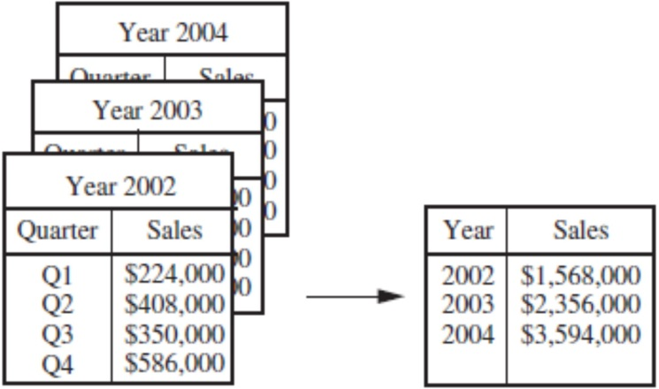
The cube can be created in three ways,
i. Base cuboid:
The cube created at the lowest level of abstraction is reffered to as base cuboid.
ii.Lattice of cuboid:
Data cubes created for varying levels of abstraction are often referred to as cuboids.
iii. Apex cuboid:
A cube at the highest level of abstraction is the apex cuboid.
On the left side,the sales are shown as per quarter.On the right,the data are aggregated to provide the annual sales.

Slide 16
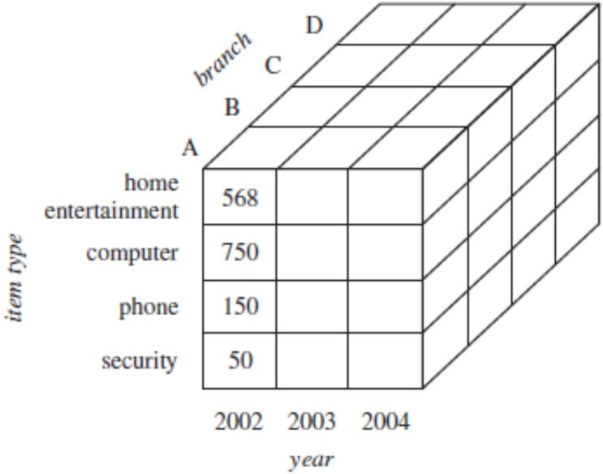
The above figure shows a data cable for multidimensional analysis of sales data with respect to annual sales per item type for each branch.

Slide 17
Basic heuristic methods for attribute subset selection include the following techniques, some of which are illustrated.
Stepwise forward selection:
The procedure starts with an empty set of attributes as the reduced set. The best of the original attributes is determined and added to the reduced set. At each subsequent iteration or step, the best of the remaining original attributes is added to the set
Example:
Let us consider the following actual set of attributes,
{A1, A2, A3, A4, A5, A6}
Initial attributes set {A1, A2, A3, A4, A5, A6}
Initial reduced set
{ }
{A1}
{A1, A4}
{A1, A4, A6} Reduced attribute set.

Slide 18
Stepwise backward elimination:
The procedure starts with the full set of attributes.At each step, it removes the worst attribute remaining in the set.
Example:
Initial attributes set {A1, A2, A3, A4, A5, A6} Initial reduced set
{A1, A2, A3, A4, A5, A6}
{A1, A3, A4, A5, A6}
{A1,A4,A5,A6}
{A1, A4, A6} Reduced attribute set.
Combination of forward selection and backward elimination:
The stepwise forward selection and backward elimination methods can be combined so that, at each step, the procedure selects the best attribute and removes the worst from among the remaining attributes.
Decision tree induction:
Decision tree algorithms such as ID3,C4.5 and cart were originally intended of classification. A decision tree is a tree structure and consists of three types of nodes they are root nodes, internal nodes, and leaf or terminal nodes.

Slide 19
Data Transformation
The different techniques that are used for performing data transformation are
Smoothing of noisy data.
Aggregation of data cube.
Generalization of data.
Normalization of data.
Construction of attributes/features.
Smoothing:
Smoothing, which works to remove noise from the data. Such techniques include binning, regression, and clustering.
Aggregation:
Aggregation, where summary or aggregation operations are applied to the data. For example, the daily sales data may be aggregated so as to compute monthly and annual total amounts.
Generalization:
Generalization of the data, where low-level or raw data are replaced by higher-level concepts through the use of concept hierarchies. For example, categorical attributes, like a street, can be generalized to higher-level concepts, like city or country.
Normalization:
Normalization, where the attribute data are scaled so as to fall within a small specified range, such as −1. 0 to 1.0, or 0.0 to 1.0.
An attribute is normalized by scaling its values so that they fall within a small specified range, such as 0.0 to 1.0.

Slide 20
Normalization is particularly useful for classification algorithms involving neural networks, or distance measurements such as nearest-neighbor classification and clustering.
There are many methods for data normalization. Some of the methods used for normalization are
Min-max normalization,
Z-score normalization,
Normalization by decimal scaling.
5. Attribute Construction:
In attribute construction, new attributes are constructed from the given attributes and added in order to help improve the accuracy and understanding of structure in high- dimensional data.

Slide 21
methods that are used for data discretization
Supervised discretization.
Unsupervised discretization.
Top-down discretization.
Bottom-up discretization.
Supervised dicretization:
If the discretization process uses class information, then it is supervised discretization.
Unsupervised discretization:
If the discretization process does not use any class information, but the data values are reduced by substituting them by limited interval descriptions, then it is unsupervised.
Top-down discretization (or) splitting:
If the discretization process starts by first finding one or a few points (called split points or cut points) to split the entire attribute range and then repeat the recursively on the resulting intervals, then it is called top down discretization.
Bottom-up discretization (or) merging:
This process starts by considering all the continuous attribute values as split points, removes some by merging neighborhood values to form intervals and then recursively apply this process to resulting intervals.

